Slide 1



Prize Comparison
View in Power BI
Last data refresh:
9/28/2024 8:27:11 AM UTC
Downloaded at:
9/28/2024 8:39:10 AM UTC

Slide 2
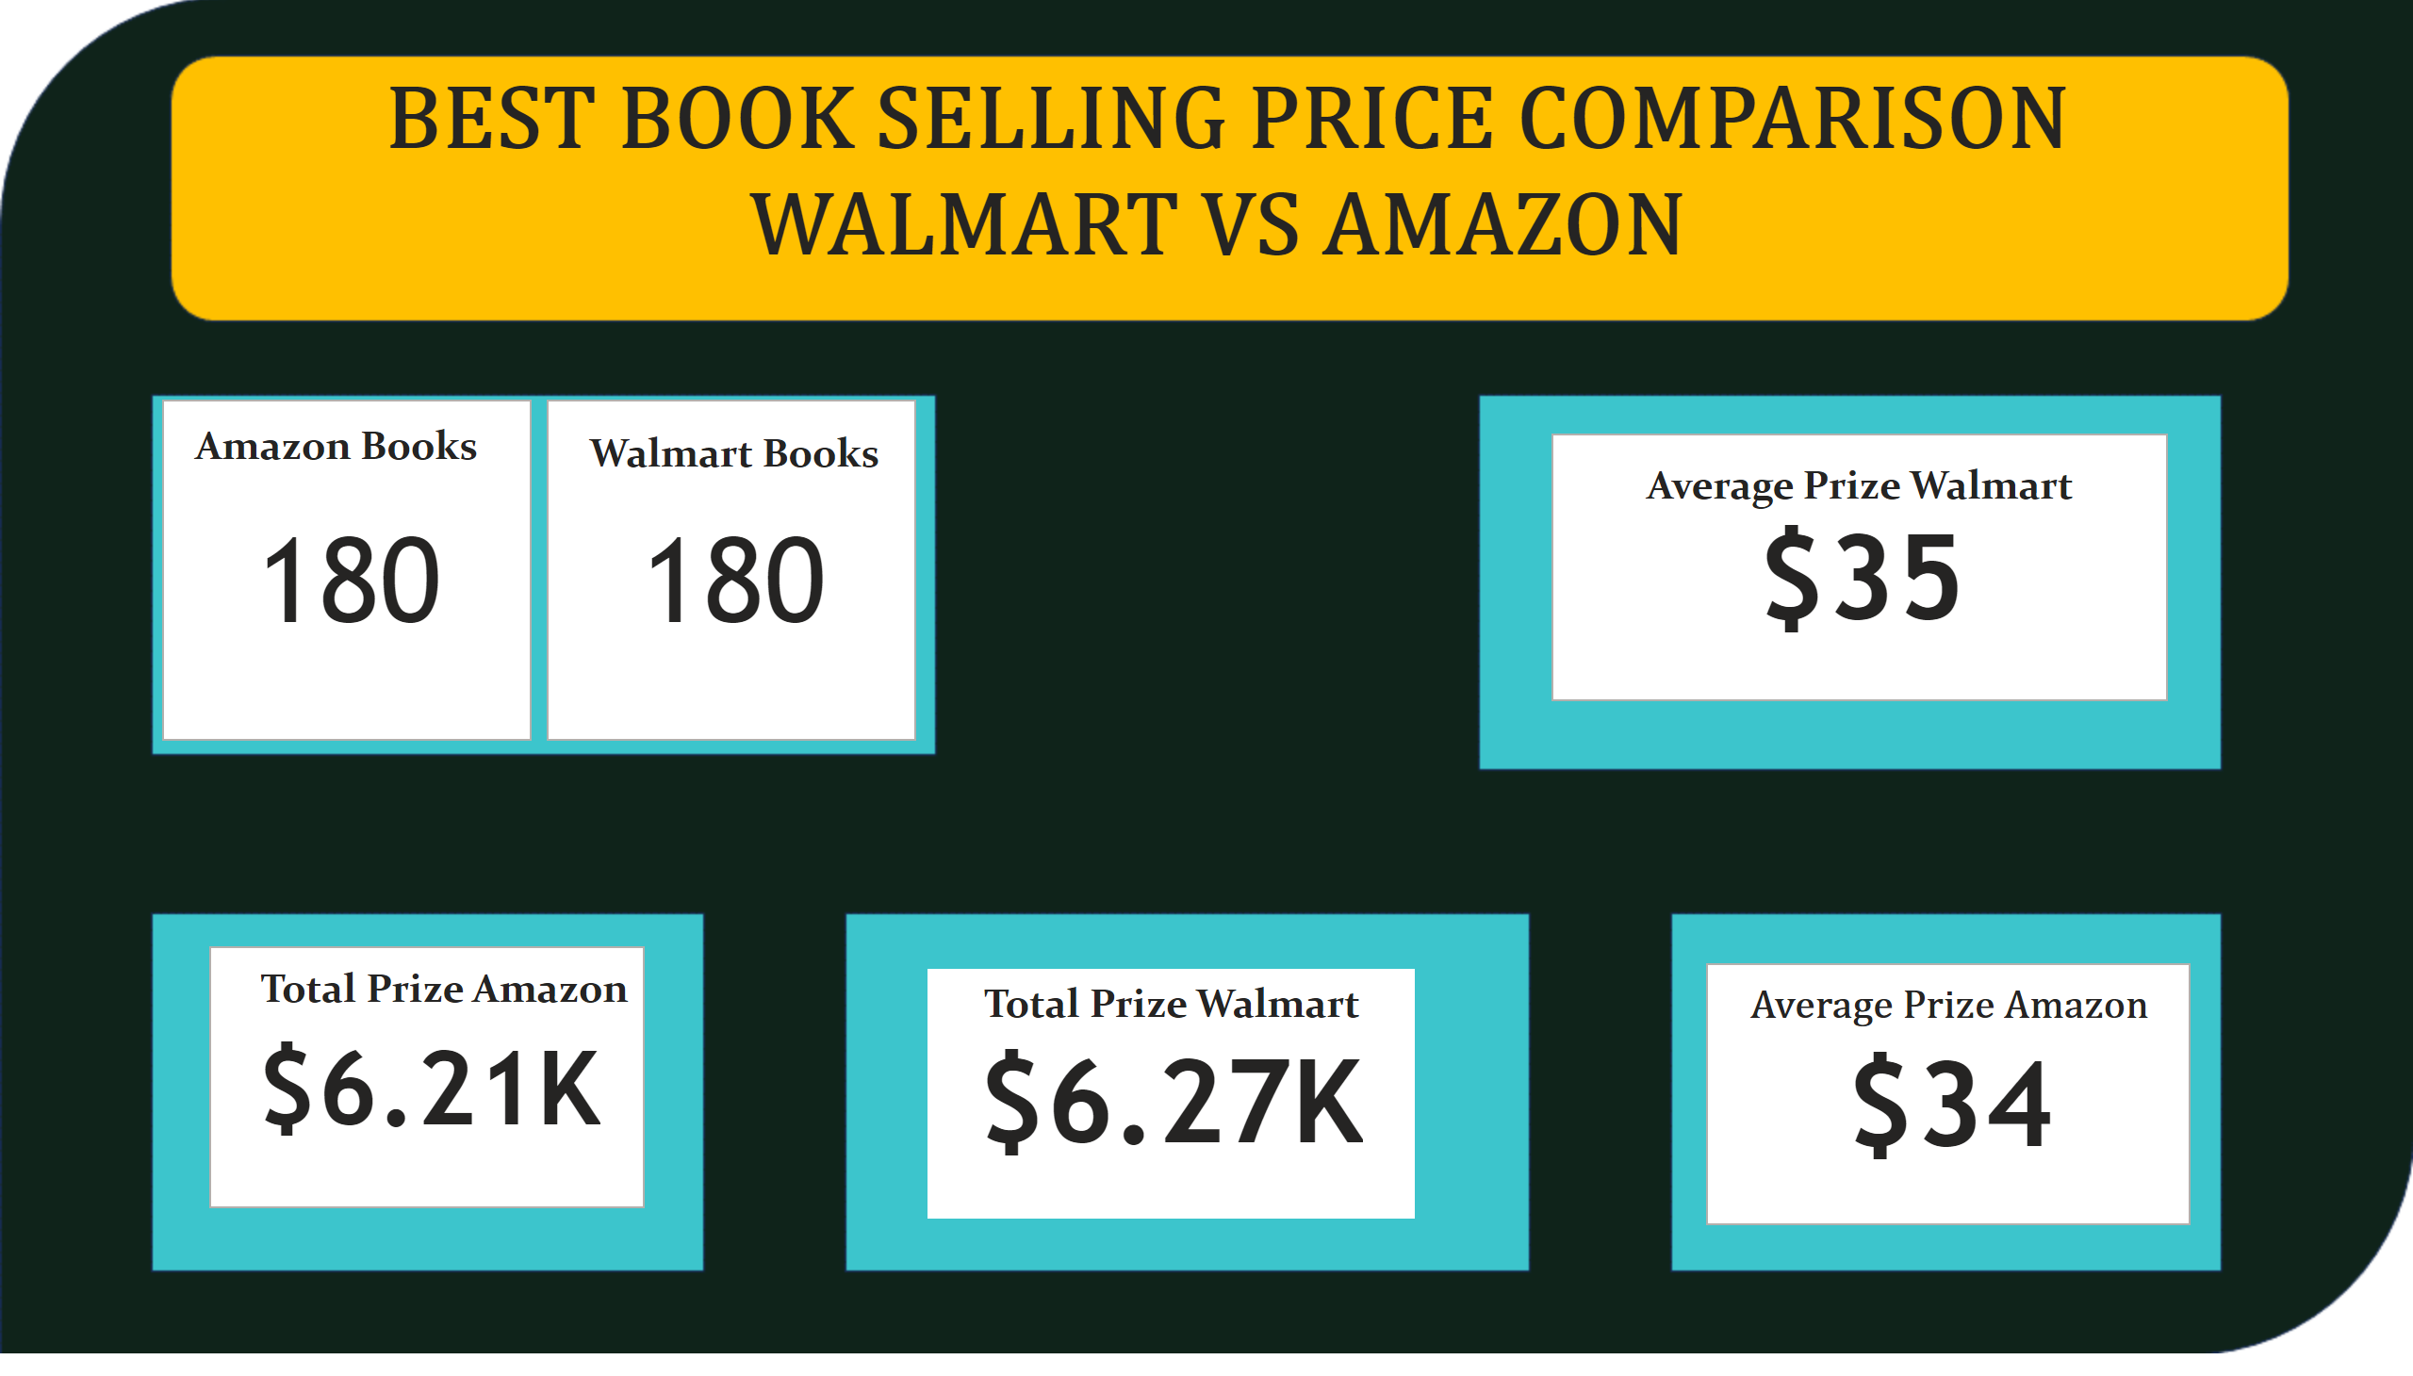
Page 2
Notes:
cardVisual
No alt text provided
cardVisual
No alt text provided
cardVisual
No alt text provided
cardVisual
No alt text provided
cardVisual
No alt text provided
textbox
No alt text provided
textbox
No alt text provided
textbox
No alt text provided
textbox
No alt text provided
textbox
No alt text provided
textbox
No alt text provided
textbox
No alt text provided

Slide 3
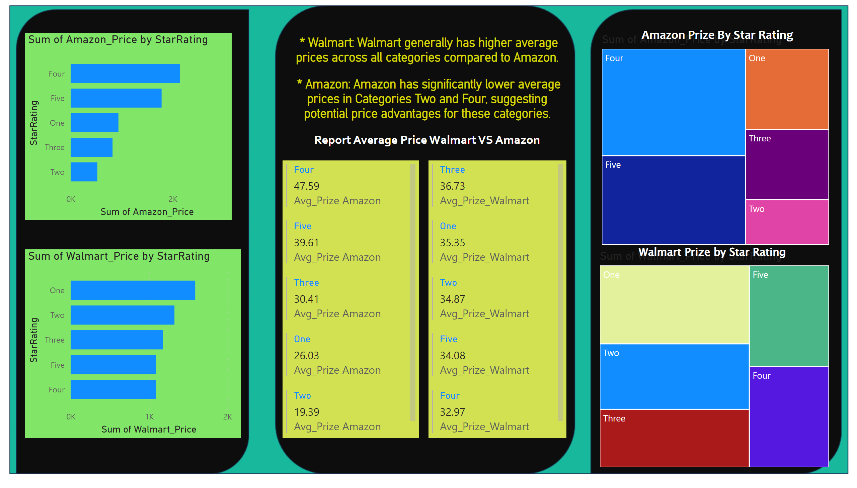
Page 3
Notes:
barChart
No alt text provided
barChart
No alt text provided
multiRowCard
No alt text provided
multiRowCard
No alt text provided
treemap
No alt text provided
treemap
No alt text provided
textbox
No alt text provided
textbox
No alt text provided
textbox
No alt text provided
textbox
No alt text provided

Slide 4
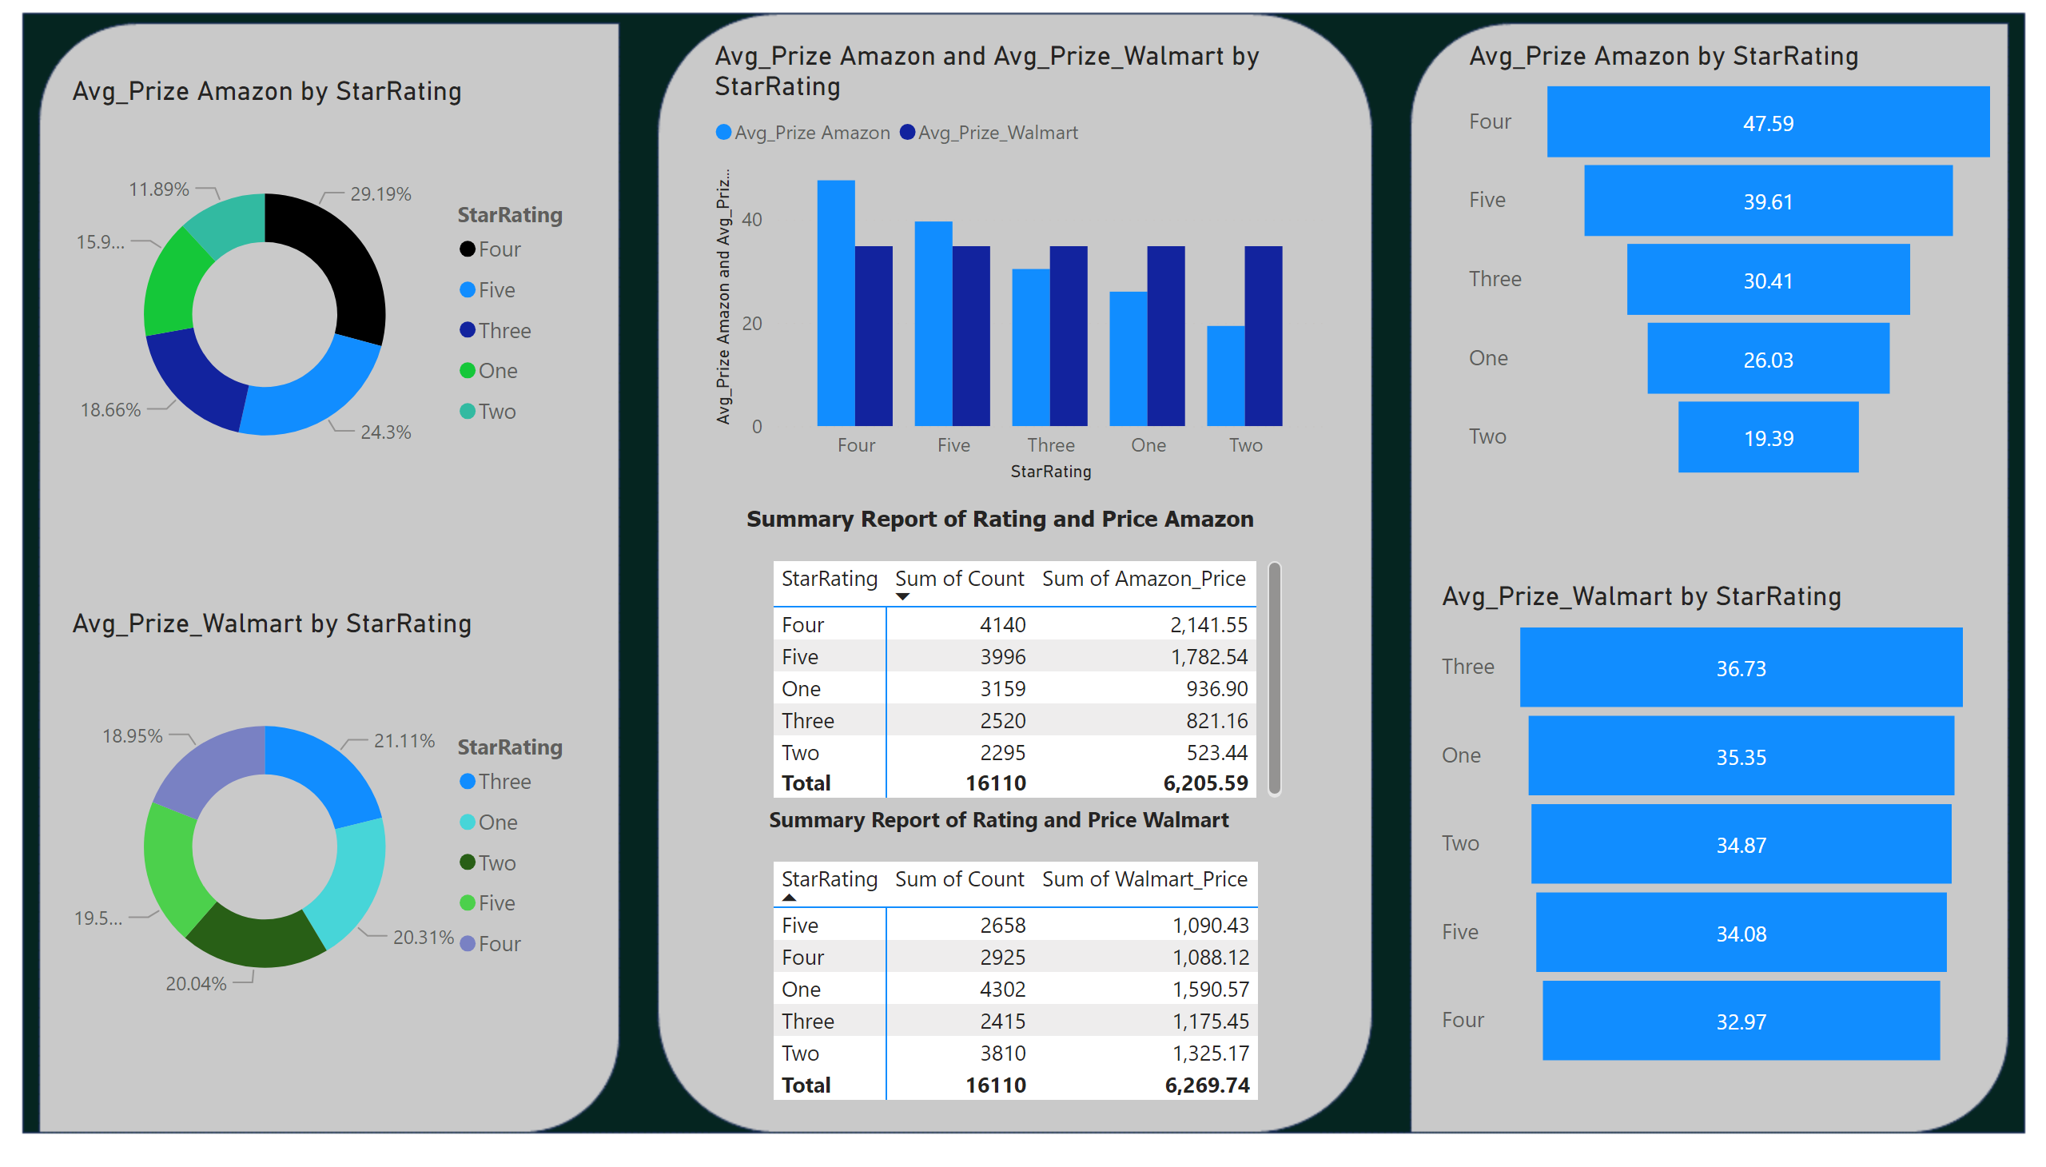
Page 4
Notes:
donutChart
No alt text provided
donutChart
No alt text provided
clusteredColumnChart
No alt text provided
funnel
No alt text provided
funnel
No alt text provided
pivotTable
No alt text provided
pivotTable
No alt text provided
textbox
No alt text provided
textbox
No alt text provided

